Slide 1
Classification and Prediction
Classification by decision tree induction

Slide 2
Classification and Prediction
Basic Concepts
Issues Regarding Classification and Prediction
Decision Tree
Bayesian Classification
Neural Networks
Associative classification
Classification Accuracy

Slide 3
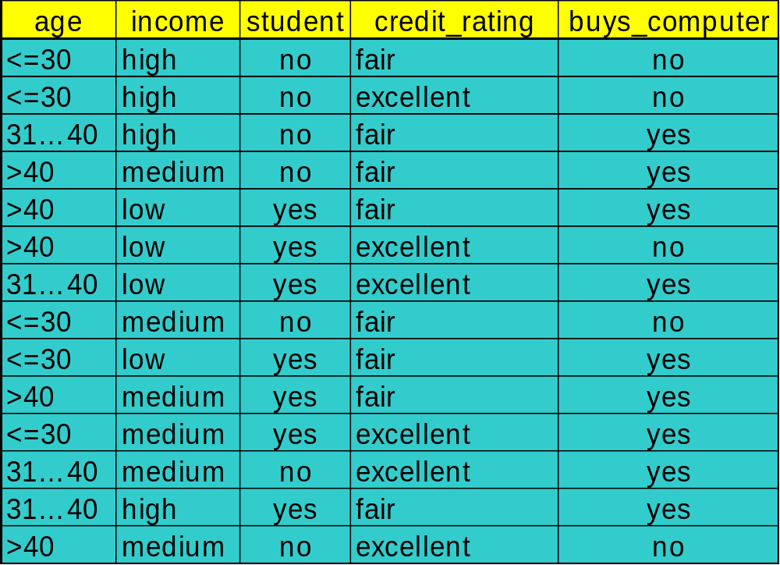
Training Dataset
This follows an example from Quinlan’s ID3

Slide 4
Training Dataset
age | income | student | credit_rating | buys_computer
<=30 | high | no | fair | no
<=30 | high | no | excellent | no
<=30 | medium | no | fair | no
<=30 | low | yes | fair | yes
<=30 | medium | yes | excellent | yes
>40 | medium | no | fair | yes
>40 | low | yes | fair | yes
>40 | low | yes | excellent | no
>40 | medium | yes | fair | yes
>40 | medium | no | excellent | no
31…40 | high | no | fair | yes
31…40 | low | yes | excellent | yes
31…40 | medium | no | excellent | yes
31…40 | high | yes | fair | yes

Slide 5
Output: A Decision Tree for “buys_computer”
age?
<=30
overcast
>40
30..40
student?
yes
credit rating?
no
yes
excellent
fair
no
yes
no
yes

Slide 6
Algorithm for Decision Tree Induction
基本算法 (a greedy algorithm)
  用一种自上而下递归的分治方式构建决策树
  开始，所有的训练例子都在根目录
  属性是分类的(如果是连续值，事先就被离散化了)
  例子是在选定属性的基础上分区递归的
  在探试的或者统计的措施基础上选择测试属性 (例，信息增益)
停止分裂的条件
  对于一个给定的节点，所有的样本属于同一类
  没有剩余的属性用于进一步分区—分类叶子采用多数投票的方式
  没有样本剩下

Slide 7
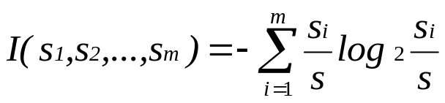
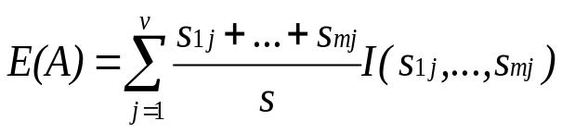

Attribute Selection Measure: Information Gain (ID3/C4.5)
选取有最高信息增益的属性
S contains si tuples of class Ci for i = {1, …, m}
Information衡量任意元祖进行分类所需的信息
拥有值 {a1,a2,…,av}的属性A的熵
information gained（信息增益） by branching on attribute A

Slide 8
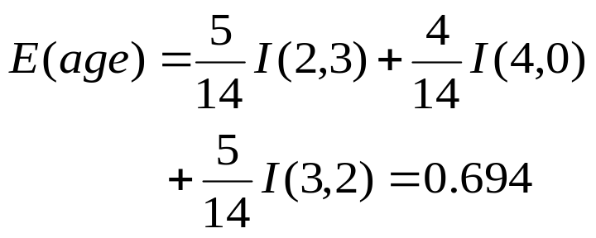


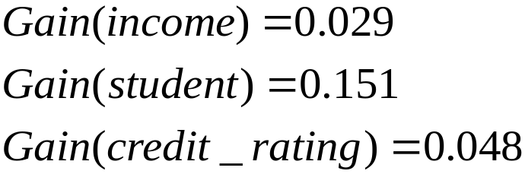
Attribute Selection: Information Gain
Class P: buys_computer = “yes”
Class N: buys_computer = “no”
I(p, n) = I(9, 5) =0.940
Compute the entropy for age:
means “age <=30” has 5 out of 14 samples, with 2 yes’es and 3 no’s. Hence
Similarly,

Slide 9
Computing Information-Gain for Continuous-Value Attributes
让属性A是一个连续值属性
必须确定A的一个最佳分割点
  将属性A的值升序排列
  通常，每对相邻值之间的中点被视为一个可能的分割点
    (a_{i}+a_{i+1})/2 是 a_{i} 和 a_{i+1}的中点
    with the minimum expected information requirement for A is selected as the split-point for A
Split:
  D1 是D中满足A ≤ split-point,的元组集， D2 是D中满足 A > split-point的元组集

Slide 10
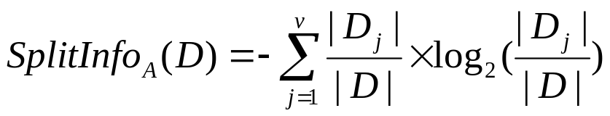
Gain Ratio for Attribute Selection (C4.5)
信息增益度量偏重于有很多值的属性
C4.5 (ID3的一个继任者) 用增益比率克服这个困难(信息增益的标准化)
  GainRatio(A) = Gain(A)/SplitInfo(A)
Ex.
  gain_ratio(income) = 0.029/0.926 = 0.031
有最大增益比的属性被选为分割属性

Slide 11



Gini index (CART, IBM IntelligentMiner)
如果一个数据集D包含n类的例子,基尼系数, gini(D) 被定义为
其中 p_{j} is是D中j类的相对频率
如果一个数据集D被分割为两个子集 D₁ 和 D₂，基尼系数gini(D) 被定义为
减少杂质:
提供最小 gini_{split}(D) (或杂质减幅最大) 的属性被选择去分裂节点 (需要列举每个属性的所有可能的分割点)

Slide 12


Gini index (CART, IBM Intelligent Miner)
Ex. D has 9 tuples in buys_computer = “yes” and 5 in “no”
Suppose the 假设attribute income 在D₁中将D分成10区: {low, medium} and 在D₂中分成4区
  but gini_{{medium,high}} is 0.30 and thus the best since it is the lowest
所有属性假定为连续值的
可能需要其他工具, 例如,聚类，得到可能的分割值
分类属性可以修改

Slide 13
Comparing Attribute Selection Measures
这三个度量总体上返回了好的结果，但是
  Information gain信息增益:
    biased towards multivalued attributes偏重于多值属性
  Gain ratio增益比率:
    tends to prefer unbalanced splits in which one partition is much smaller than the others倾向于不平衡的分割，一个分区比其他的都要小很多
  Gini index基尼系数:
    biased to multivalued attributes偏重于多值属性
    has difficulty when the number of classes is large当类别数量很多时有困难
    tends to favor tests that result in equal-sized partitions and purity in both partitions倾向于那些导致同等大小分区和两个分区内有同等纯度的测试

Slide 14
Other Attribute Selection Measures
CHAID: a 一种流行的基于 χ² t测试的决策树算法
C-SEP: 在某些案例中比信息增益和基尼系数表现良好
G-statistics: 与 χ² 分布很接近
MDL 原则(Minimal Description Length最小描述长度) (即，越简越好):
  The best tree as the one that requires the fewest number of bits to both (1) encode the tree, and (2) encode the exceptions to the tree需要最少数量位（1）去编码树，（2）编码树的例外，这样的树是最好的
Multivariate splits 多元分裂(partition based on multiple variable combinations基于多变量组合分区)
  CART: finds multivariate splits based on a linear comb. of attrs.找到基于属性线性组合的多变量分割
Which attribute selection measure is the best那个属性选择度量是最好的?
  Most give good results, none is significantly superior than others多数给出良好的结果，没有哪一个比其他的要显著好

Slide 15
Extracting Classification Rules from Trees
用IF-THEN规则的形式表示知识
为每个从根到叶的路径创建一个规则
沿路径的每个属性值对形成一个连接
叶节点拥有类预测
规则更容易理解
例
  IF age = “<=30” AND student = “no” THEN buys_computer = “no”
  IF age = “<=30” AND student = “yes” THEN buys_computer = “yes”
  IF age = “31…40” THEN buys_computer = “yes”
  IF age = “>40” AND credit_rating = “excellent” THEN buys_computer = “yes”
  IF age = “<=30” AND credit_rating = “fair” THEN buys_computer = “no”

Slide 16
Enhancements to basic decision tree induction
Allow for continuous-valued attributes允许连续值属性
  动态定义新的离散值属性，将连续属性值分割成一组离散的间隔
Handle missing attribute values处理遗失属性值
  Assign the most common value of the attribute指定属性的最常见的值
  Assign probability to each of the possible values分配概率到每一个可能的值
Attribute construction属性构建
  Create new attributes based on existing ones that are sparsely represented基于现有的很少被代表的创建新的属性
  这减少碎), 重复, 和复制

Slide 17
Classification in Large Databases
Classification分类—一个被统计学家和机器学习研究者广泛研究的经典问题
Scalability可扩展性: 以合理的速度，用百万计的例子和数百的属性分类数据
Why decision tree induction in data mining为什么决策树被引入数据挖掘?
  relatively faster learning speed (than other classification methods)学习速度较快（比其他的分类方法）
  convertible to simple and easy to understand classification rules转换为简单、易于理解的分类规则
  can use SQL queries for accessing databases可以使用SQL查询访问数据库
  comparable classification accuracy with other methods与其他方法相媲美的分类精度

Slide 18
Scalable Decision Tree Induction Methods in Data Mining Studies
SLIQ (EDBT’96 — Mehta et al.)
  builds an index for each attribute and only class list and the current attribute list reside in memory建立一个为每个属性和唯一的类列表和当前属性列表驻留在内存中的索引
SPRINT (VLDB’96 — J. Shafer et al.)
  constructs an attribute list data structure构造一个属性列表的数据结构
PUBLIC (VLDB’98 — Rastogi & Shim)
  integrates tree splitting and tree pruning: stop growing the tree earlier集成树的分裂和树的修剪：尽早停止树的生长
RainForest (VLDB’98 — Gehrke, Ramakrishnan & Ganti)
  separates the scalability aspects from the criteria that determine the quality of the tree从决定树的质量的标准中分离可扩展方面
  builds an AVC-list (attribute, value, class label)建立AVC列表（属性，值，类标签）

Slide 19

Presentation of Classification Results

Slide 20

Visualization of a Decision Tree in SGI/MineSet 3.0

